Slide 1




Natural Language Processing with Disaster Tweets
Abhinay Reddy Guntipally - aguntipa@kent.edu - 811176661
Vineeth Billa kanti - vbillaka@kent.edu - 811192961
Sai Kumar Reddy Nossam - snossam@kent.edu - 811167869
Likitha Guthikonda - lguthiko@kent.edu - 811150752

Slide 2
INDEX
Project Objective
What is NLP?
What is Text Classification?
Why Choose a Deep Learning Model for this Classification?
What is BERT?
Why BERT?
How does BERT work?
Identifying Customers & End-Users?
Constraints Imposed by a Customer & Assumptions and Risks
Expected Tools
Acknowledgements & References

Slide 3
Project Objective
Twitter has grown to be a crucial communication tool during emergencies. Smartphones are so common that anybody may instantly report an emergency they are seeing. As a result, more companies are interested in automating Twitter monitoring (i.e. disaster relief organizations and news agencies).Due to the unpredictable and dangerous nature of natural disasters, it is critical to gather relevant information and data about disasters as soon as possible; this helps humanitarian groups prioritize their work.
The purpose of this project is to develop a machine learning model that can determine which Tweets are about actual disasters and which ones are not. We have access to a dataset of 10,000 tweets that were manually categorized.

Slide 4
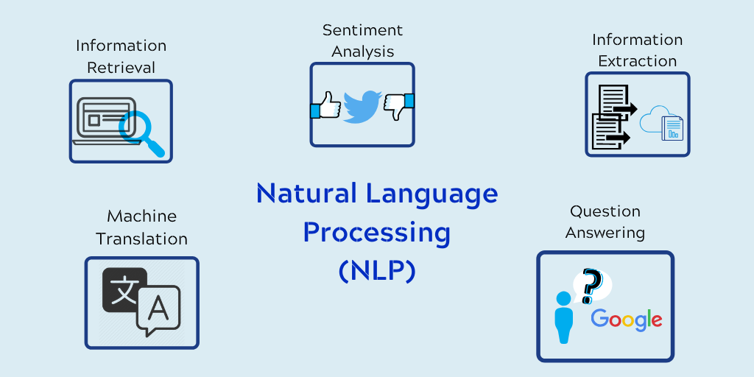
What is NLP?
The branch of artificial intelligence known as natural language processing, or NLP, allows computers to read, comprehend, and interpret human languages. Every day, we make use of NLP, such as autocorrect when we're unsure how to spell a word.

Slide 5
What is Text Classification?
One of the most exciting uses of NLP is text classification. It is described as the method of classifying free-text based on its content. Unstructured text may be found everywhere—in emails, conversations, social media posts, online pages, and other places. Businesses nowadays are focusing on text categorization to efficiently structure content and automate procedures.
Text classifiers, for instance, can categorize a variety of news items in accordance with their content with ease. This classifier's output contains sections for politics, sports, entertainment, business, and other topics.

Slide 6
Why Choose a Deep Learning Model for this Classification? There is a significant amount of active study in this topic. In the beginning, machine learning models were used. However, when the amount of picture and video attachments to tweets increased, these models performed poorly. In contrast, deep learning architectures such as CNN, LSTM, BERT, ResNet34, VGG-16, etc. have shown superior consistency and performance. Here, we have decided to use the BERT Model.

Slide 7
What is BERT?
Google developed Bidirectional Encoder Representations from Transformers (BERT), a transformer-based machine learning approach for pre-training natural language processing (NLP).
Jacob Devlin and his Google coworkers developed and released BERT in 2018. In 2019, Google announced that it has started using BERT in its search engine, and by late 2020, it was employing BERT in almost all English-language queries.

Slide 8
Why BERT?
BERT is backed by Transformer and it’s core principle - attention, which understands the contextual relationship between different words. Rather than decoding the encoded information, BERT only encodes and generates a language model, so an encoder is enough. As compared to directional models such as RNN and LSTM which conceive each input sequentially (left to right or right to left). In fact, Transformer and BERT are non-directional - to be very precise, because both these models read the whole sentence as the input instead of sequential ordering. This characteristic allows models to learn the contextual information of a word with respect to all other words in the sentence.

Slide 9
How does BERT work?
Language modeling (15% of tokens were masked, and BERT was taught to interpret them from context) and next sentence prediction were the two tasks that BERT had been pretrained on (BERT was trained to predict if a chosen next sentence was probable or not given the first sentence). BERT gains knowledge of word contextual embeddings as a result of training.

Slide 10
Identifying Customers & End Users
Identifying Customers
A customer is the purchaser of a product or service. This individual may or may not be an end user. Typically, the first responders to disasters such as natural disasters are police, firemen, paramedics, or emergency medical technicians (EMT), disaster relief organizations, and news agencies. The primary duty of first responders is to guarantee the safety of individuals. All these government agencies can be considered customers, as well as any private organizations who would like to aid during natural disasters.
Identifying End-Users
An end user is a consumer of the product or service. This person may or may not be a customer. It might be a member of the organization or a person with whom the customer wants to do business. So, our end users can be common people, and the employees in disaster relief organizations, and news agencies.

Slide 11
Constraints Imposed by the Customer & Assumptions and Risks
Constraints Imposed
Since disaster management organizations may utilize tweets and messages, prediction precision is of the utmost importance.
Noise and Outliers are components of the dataset that must be handled with exceptional care to increase the accuracy of the model.
There is no need for sub-second latency. However, the execution of training or inference should not take too long.
Assumptions & Risks
A naive assumption regarding new occurrences is that those including the keywords "outbreak" and "wreckage" are likely to be about disasters. But those containing "Armageddon" and "body" are likely to be about non-disasters.
There are many other aspects to consider. For example, if someone was during a natural disaster, would they write longer or shorter tweets, would they use punctuation?
Stakeholder issues, such as insufficient engagement and false expectations, pose a further threat.

Slide 12
Expected Tools
We can complete the project in our free, no-setup Jupyter Notebooks environment even if we don't have a lot of personal computing power since the project's dataset is not too large.

Slide 13

Acknowledgements
Thanks to Prof. Dr. Ruoming Jin, who kindly agreed to serve as our project's stakeholder, has been an invaluable resource in guiding the project.
References
1. I. Maulana and W. Maharani, "Disaster Tweet Classification Based On Geospatial Data Using the BERT-MLP Method," 2021 9th International Conference on Information and Communication Technology (ICoICT), 2021, pp. 76-81, doi: 10.1109/ICoICT52021.2021.9527513.
2. Y. Chandra and A. Jana, "Sentiment Analysis using Machine Learning and Deep Learning," 2020 7th International Conference on Computing for Sustainable Global Development (INDIACom), 2020, pp. 1-4, doi: 10.23919/INDIACom49435.2020.9083703
3. L. Xukun and D. Caragea, "Improving Disaster-related Tweet Classification with a Multimodal Approach", ISCRAM 2020 Conference Proceedings-17th International Conference on Information Systems for Crisis Response and Management, 2020
4. Abhinav Kumar, Jyoti Prakash Singh, Yogesh K. Dwivedi and Nripendra P. Rana, A deep multi-modal neural network for informative Twitter content classification during emergencies, Springer, pp. 1-32, 2020

Slide 14


